Slide 1
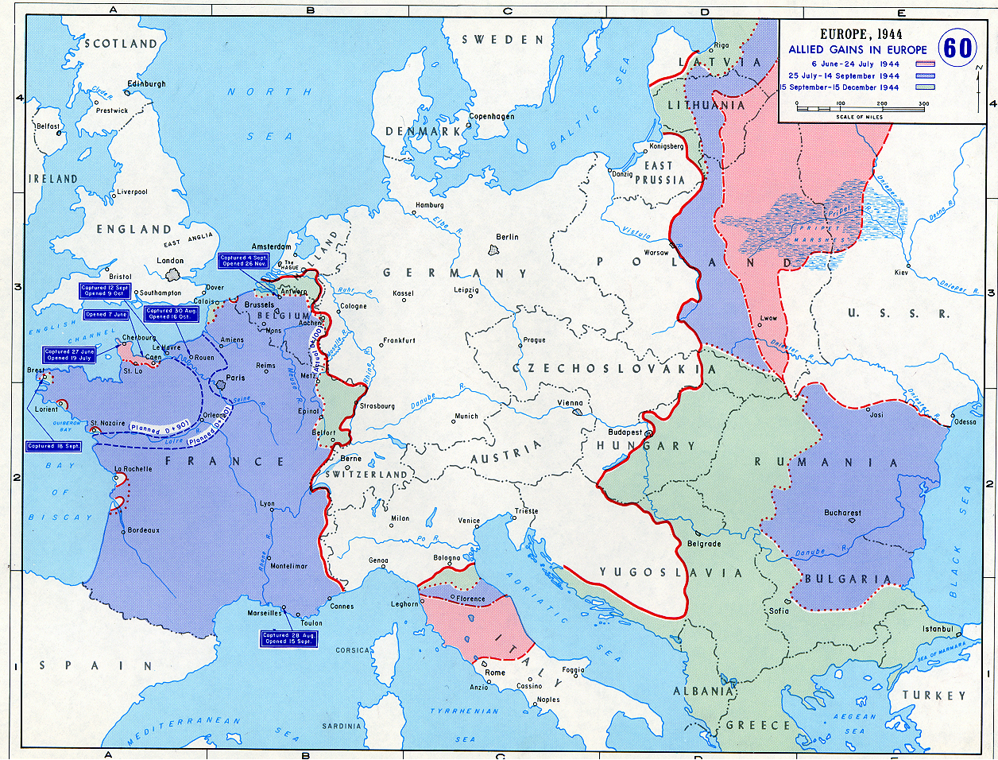
Peememunde
Missle Base
Merseburg
Synthetic Fuel Plant
Bob Stewart’s Bombing Locations (June 6 – Sept. 30 1944)
Notes:
Bob Stewart’s Flights:
From 6 June 1944 (talk about a day to have your first flight) to 30 September 1944
Normandy- 4 flights
The Loire River Valley- 2
Pas de Calais- 2
St Lo- 2
These were all in support of the troops moving eastward after D day
Toulousse- 1- Dad has no memory of why they went there
Nijmegen (Holland)- 1- A bridge too Far- Arnhem
Hamburg- 2
Berlin-2
Munich-2
Leipzig- 2
Merseburg- 2 (Just south of Leipzig- synthetic fuel plant there)
Bremen- 2
Ludweghaven- 1
Stuttgart- 1
Peememunde-1 (on the baltic Sea, just opposite Malmo in Sweden- bombing a missle base- Dad could see Malmo out of his window as he flew in
Kiel
Mannheim
Osnabruck (near Holland)
Munster (near Holland)
Questions: How old was he? What years did he fly in the war? Where was he based in Europe? How long was a typical mission? What were some major German towns he flew over / bombed? What were some specific targets? How many planes were together on a typical mission? What was it like flying in the plane? (Cold, noisy, etc.) Compare Hollywood bombing missions with the real deal. Night missions / Day missions - differences. How did he feel at the time dropping bombs on German targets? How have your feelings evolved since? Why? Compare / contrast the bombing of Germany and Japan. Was there any discussion at the time about the morality of strategic bombing between he and his crew? If so, what was it? What does he consider the most dangerous crew position on the plane and why? What was it like to come under flak? Did his plane ever encounter the Luftwaffe and if so, what was that like? What was it like to learn of other allied planes being shot down? Did he ever fear getting shot down? Did they ever write messages on their bombs? If so, what?

